Slide 2
Midterm presentation
By: Sallam Saka
Supervisors: Professor Kaley Walker and Dr. Paul Jeffery

Slide 3
About me
Name: Sallam Saka
Year: 3rd Year
Program: Biological Physics Specialist and Statistics Minor
Interests: Computational Physics and Statistics
Notes:
I would like to start with a brief introduction of myself. My name is sallam, I am a third year student, meaning I just finished my second year and I am studying Biological physics and statistics. I was interested in this research group because I was generally interested in computational physics and I saw that Dr. Kaley's project would provide me with the opportunity to further refine my interests and gain hands-on experience while learning about an aread of physics I did not know much about.

Slide 4
RESEARCH TOPIC
Instruments: ACE-FTS, OSIRIS and PEARL FTIR
Atmospheric Specie: O₃ (so far)
Objective: Examine the data quality of the various instruments
Approach: Compare measurements of the instruments against each other
Why it Matters:
Ensure instruments consistently provide accurate data
Retrieve reliable data regarding atmospheric composition
Credible science allows for evidence-based policies
Notes:
So far, my research has focused on the instruments, ACE-FTS which is short for Atmospheric Chemistry Experiment – Fourier Transform Spectrometer, OSIRIS, short for Optical Spectrogrraph and Infrared Imaging System and PEARL FTIR, also known as Bruker FTIR, at PEARL, the Polar Environment Atmospheric Research Laboratory located in Eureka Nunavut. So far, the data I have been working with are Ozone profiles and partial and/or total column data. The end goal of my research is to examine the data quality of the various instruments which is done by analyzing and validating the measurements from the instruments against eachother and has already been a lot of similar research done in the past. This types of research matter for various reasons. Firstly, comparing the data from these instruments allows us to know if any instrument has measurements that are very different from the others, which may tell us that the instrument has issues. If the instruments all agree, this also assures us that the data is highly representative of the actual atmospheric composition. Lastly, reliable data is crucial because it forms the foundation scientists need to determine effective next steps

Slide 5
INSTRUMENTS
ACE-FTS
OSIRIS
ACE-FTS is one of the two main instruments on the SCI-SAT
SCI-SAT was launched in 2003
ACE-FTS measures in the limb viewing geometry
ACE-FTS uses Fourier Transform to produce absorption spectra
ACE-FTS operates in the wavenumber range: 750–4400 cm⁻¹
OSIRIS is on-board the ODIN satellite
ODIN was launched in 2001
OSIRIS is also pointed toward the limb of earth’s atmosphere
IRI observes both scattered sunlight and airglow emission
OS obtains spectra of scattered sunlight over the range: 280–800 nm
Bernath, P. F., et al. (2005), Atmospheric Chemistry Experiment (ACE): Mission overview, Geophys. Res. Lett., 32, L15S01, doi:10.1029/2005GL022386
McLinden, C. A., and Coauthors, 2012: OSIRIS: A Decade of Scattered Light. Bull. Amer. Meteor. Soc., 93, 1845–1863, https://doi.org/10.1175/BAMS-D-11-00135.1
Llewellyn, E. J., et al. 2004. The OSIRIS instrument on the Odin spacecraft. Canadian Journal of Physics. 82(6): 411-422. https://doi.org/10.1139/p04-005
Notes:
ACE-FTS is one of the two main instruments on the SCI-SAT with the other main instrument being ACE-MAESTRO which stands for Measurement of Aerosol Extinction in the Stratosphere and Troposphere Retrieved by Occultation.
OSIRIS is on-board the ODIN satellite
SCI-SAT was launched in 2003 which is when ACE-FTS had its first recorded spectra. Routine measurements began in February of 2004.
ODIN was launched in 2001 and has made measurements since then.
Both satellites measure by looking at the limb of the earth which I will showcase on the next slide. ACE-FTS uses Fourier Transform to produce absorption spectra and ACE-FTS operates in the wavenumber range: 750–4400 cm⁻¹ which represents the middle infrared range.
IRI observes both scattered sunlight and airglow emissions from 2 infrared atmospheric bands

Slide 6
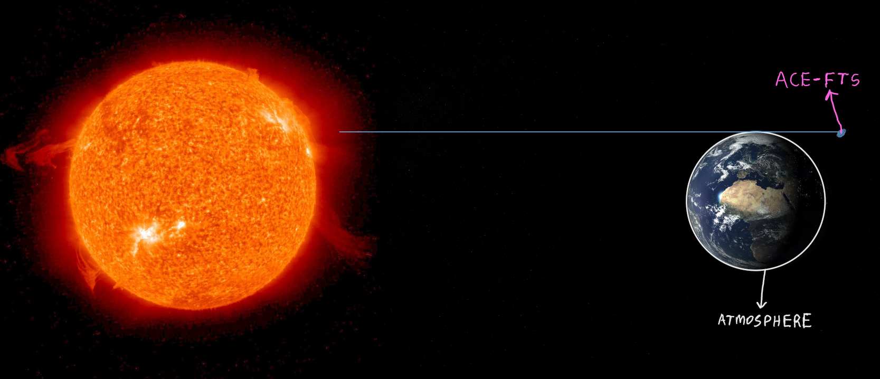
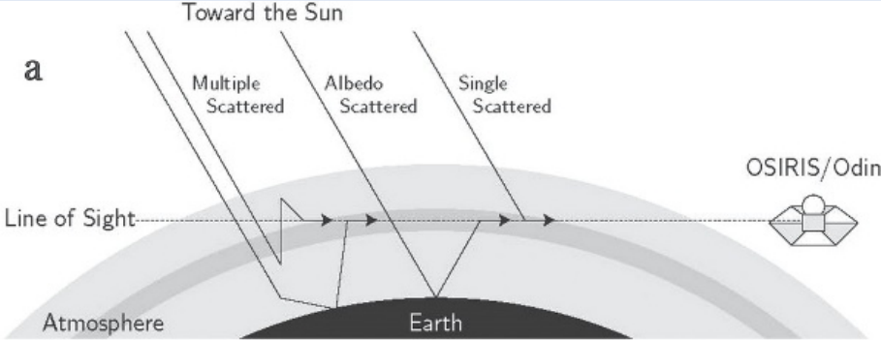
ACE-FTS AND OSIRIS Measurement geometry
ACE-FTS
OSIRIS
McLinden, C. A., and Coauthors, 2012: OSIRIS: A Decade of Scattered Light. Bull. Amer. Meteor. Soc., 93, 1845–1863, https://doi.org/10.1175/BAMS-D-11-00135.1

Slide 7
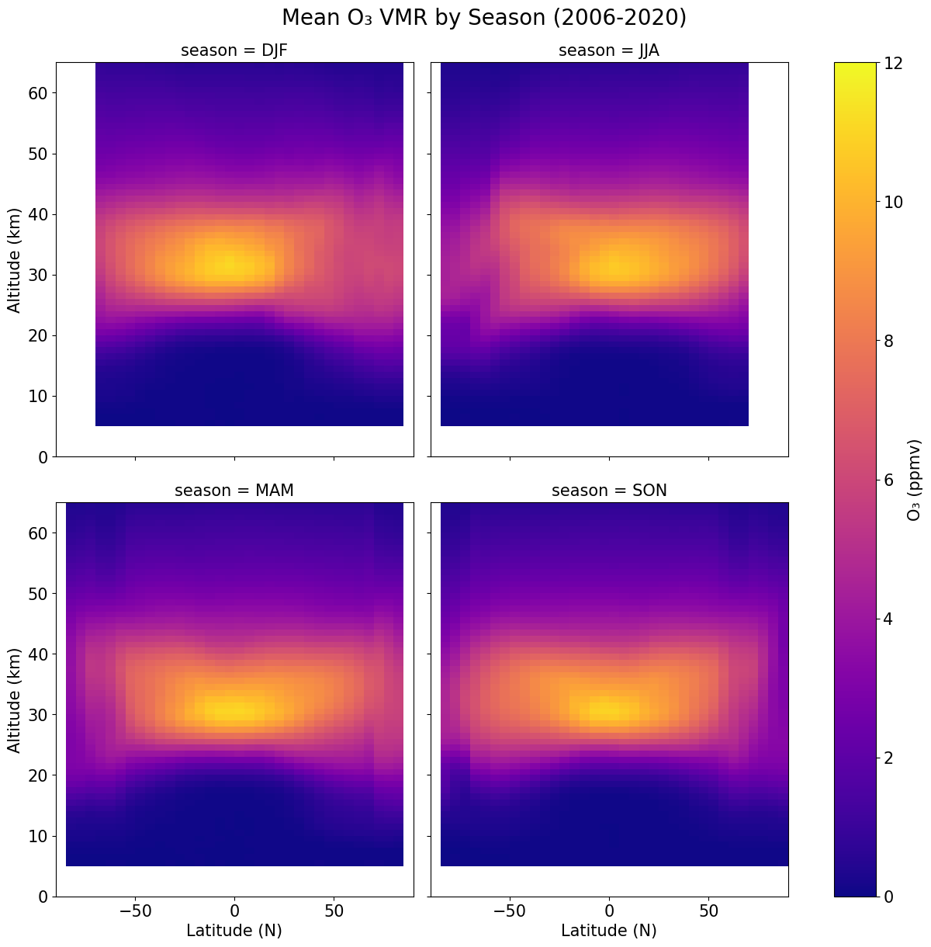
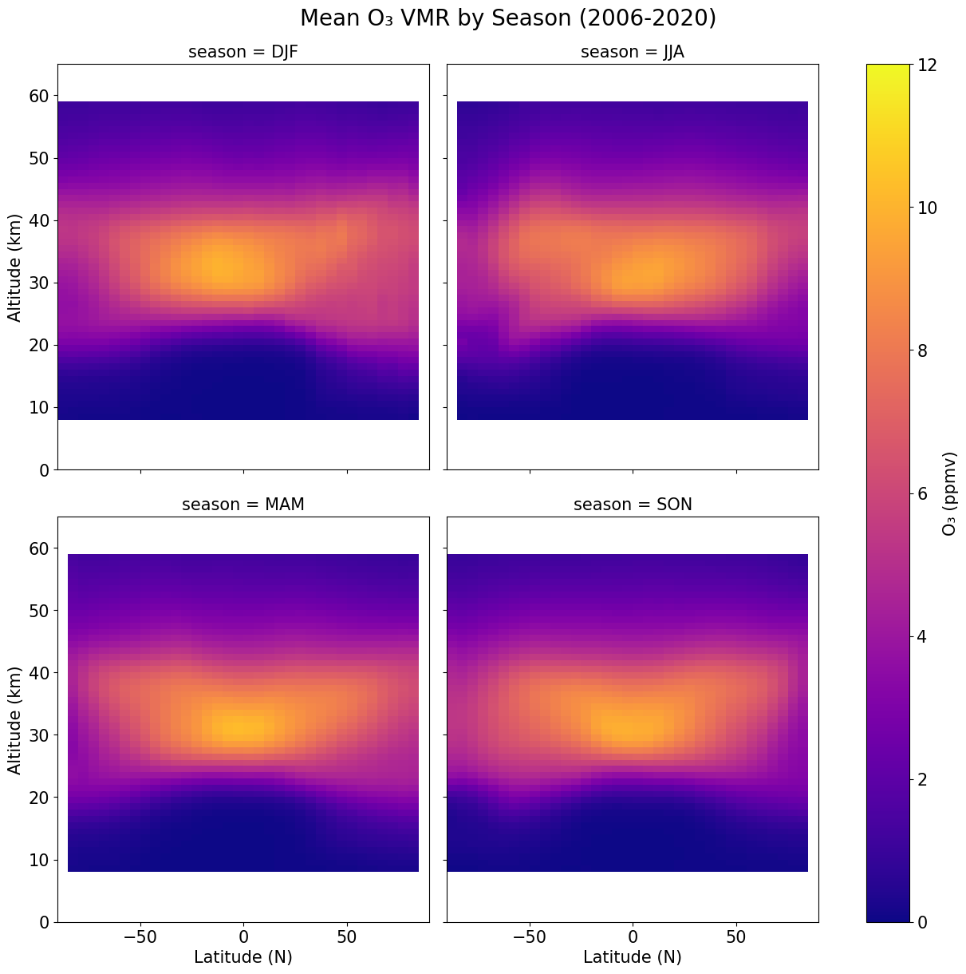
ACE-FTS
OSIRIS
Notes:
One of my first few projects was to create a climatology plot for the ACE FTS instrument. I also replicated the plot from the OSIRIS data. (talk about whats happening in the graphs? Is it expected or unexpected?). After this, I moved on to looking at the data from various latitude bands and seasons, using line plots. This allows differences to be shown more clearly rather than by trying to notice slight differences in colors is difficult.

Slide 8
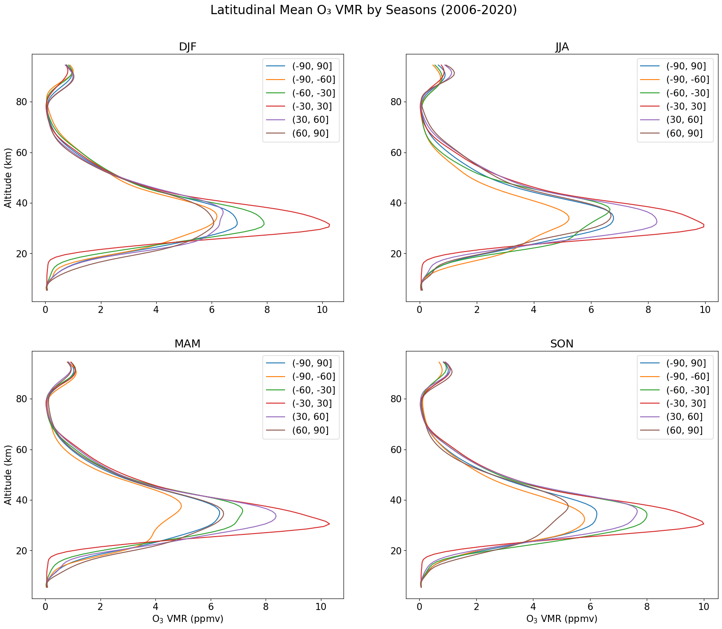
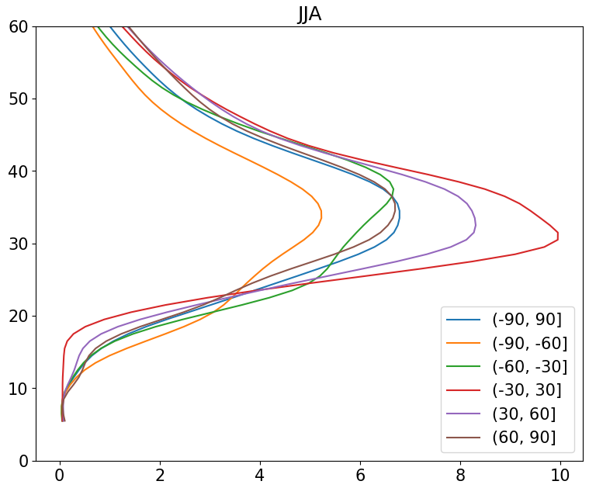
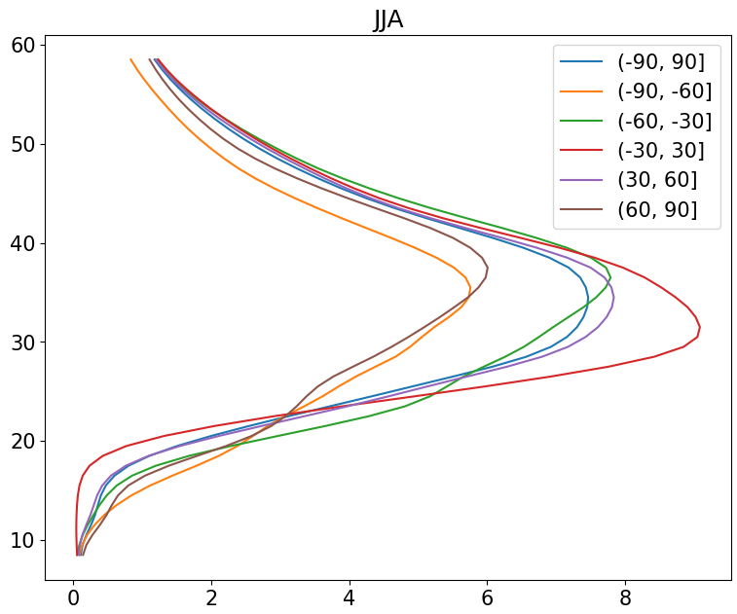
ACE-FTS
Some discrepancy
OSIRIS
Notes:
What to talk about?

Slide 9
PEARL FTIR
Also known as Bruker FTIR
Installed permanently at PEARL in July, 2006
Measures atmospheric solar absorption while the sun is up
Wavenumber ranges: 1800-8500 cm⁻¹ and 500-5000 cm⁻¹
https://eureka.physics.utoronto.ca/Eureka2020/Our_Instruments.html
Notes:
The last instrument I looked at is the PEARL FTIR ground based instrument.

Slide 10
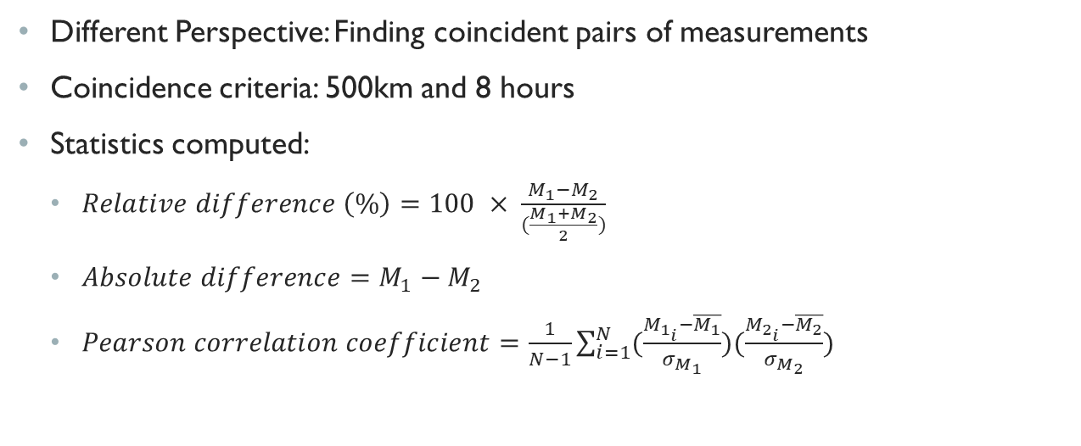
RECENT FINDINGS
Different Perspective: Finding coincident pairs of measurements
Coincidence criteria: 500km and 8 hours
Statistics computed:
$Relative difference \left(\%\right)=100 × \frac{M_{1}−M_{2}}{(\frac{M_{1}+M_{2}}{2})}$
$Absolute difference=M_{1}−M_{2}$
$Pearson correlation coefficient=\frac{1}{N−1}\sum_{i=1}^{N}{(\frac{M_{1_{i}}−\overline{M_{1}}}{σ_{M_{1}}})(\frac{M_{2_{i}}−\overline{M_{2}}}{σ_{M_{2}}})}$
Notes:
More recently, I began comparing the instruments not just by comparing their plots, but by finding individual pairs of measurements from the instruments that were within a spatial range of 500km and temporal range of 8 hours. I computed various statistics such as absolute differences which is a difference between individual pairs of measurements, relative differences which tell you how different the measurements are relative to the magnitude of the individual measurements and pearson correlation coefficients. I also computed the mean of these statistics and represented them in plots which I will show on subsequent slides.

Slide 11
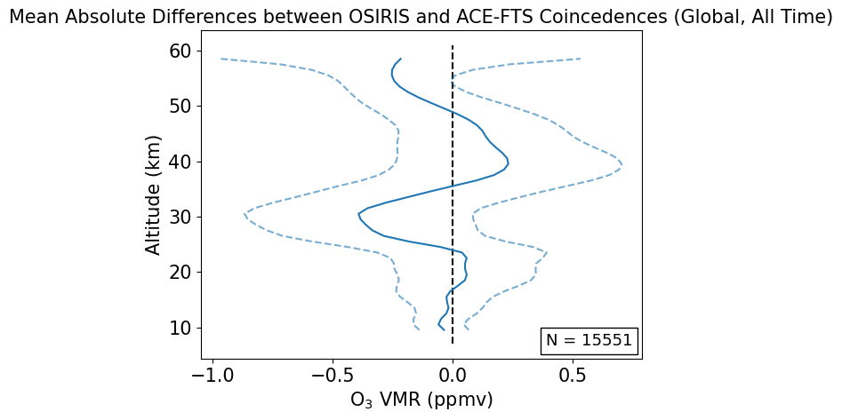
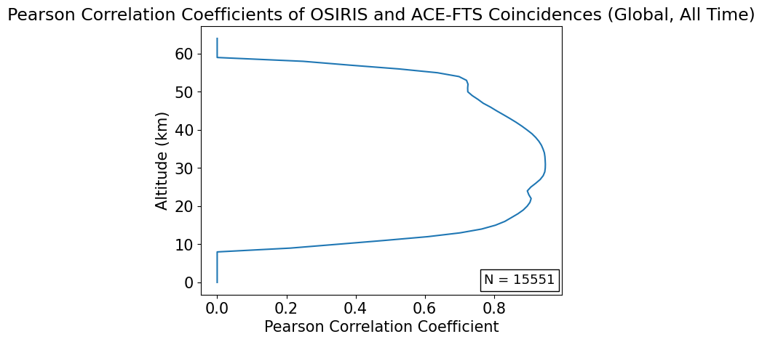
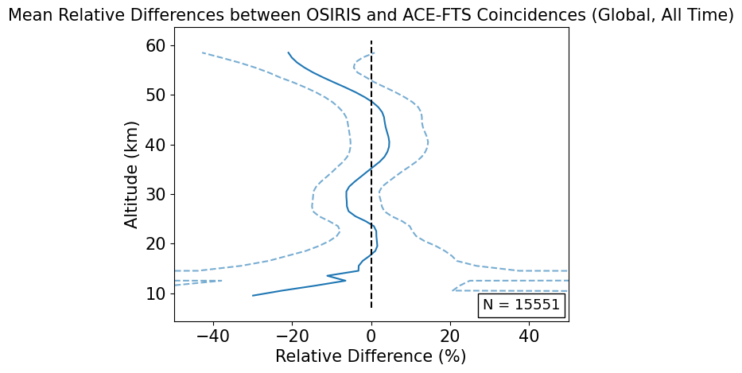
OSIRIS vs ACE-FTS OZONE PROFILE PLOTS

Slide 12
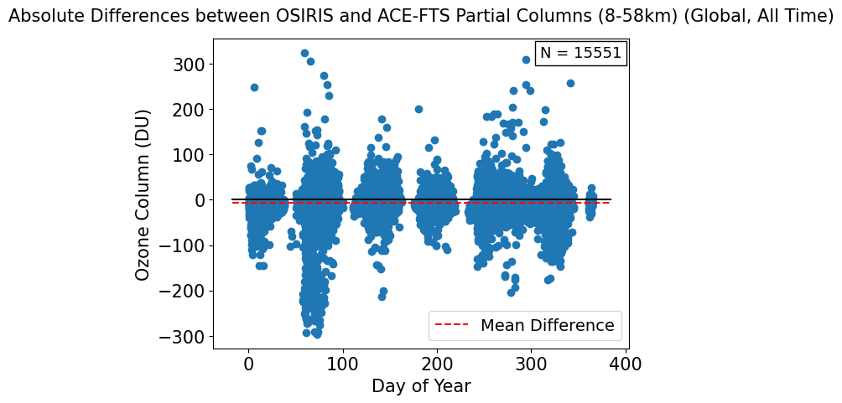
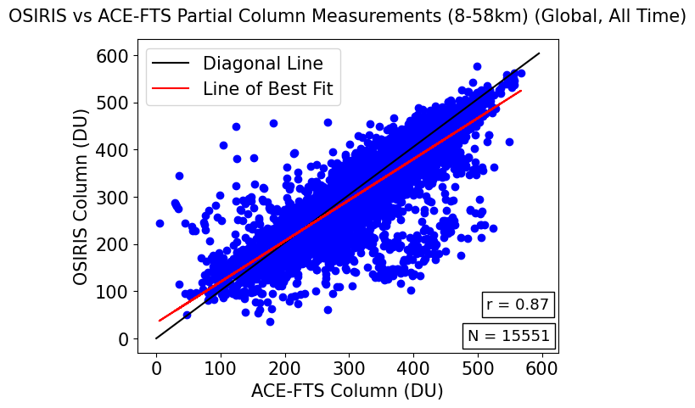
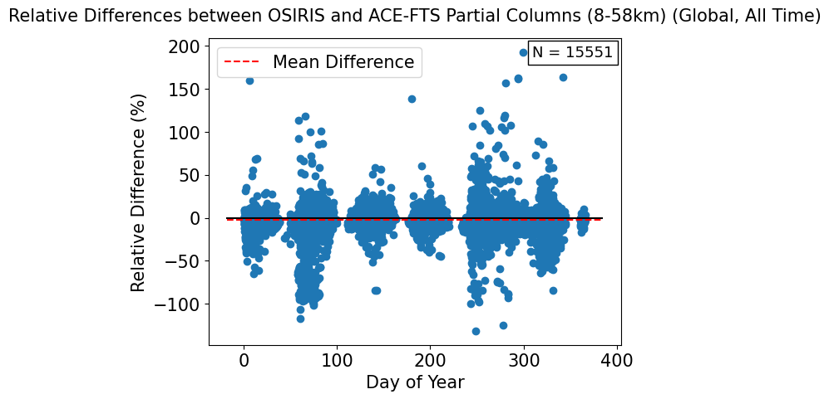
OSIRIS vs ACE-FTS OZONE Partial COLUMN PLOTS

Slide 13
REFERENCES
Bernath, P. F., et al. (2005), Atmospheric Chemistry Experiment (ACE): Mission overview, Geophys. Res. Lett., 32, L15S01, doi:10.1029/2005GL022386
McLinden, C. A., and Coauthors, 2012: OSIRIS: A Decade of Scattered Light. Bull. Amer. Meteor. Soc., 93, 1845–1863, https://doi.org/10.1175/BAMS-D-11-00135.1
Llewellyn, E. J., et al. 2004. The OSIRIS instrument on the Odin spacecraft. Canadian Journal of Physics. 82(6): 411-422. https://doi.org/10.1139/p04-005
https://eureka.physics.utoronto.ca/Eureka2020/Our_Instruments.html

Slide 14
FUTURE PLANS
Not sure what to say here yet
Notes:
Maube talk about how im looking at the AVK and using it for more precise profile and column comparisons

Slide 15

ANY QUESTIONS?

Slide 16

THANK YOU FOR YOUR TIME

